Slide 1
BMI 6018: Patient Information System
Kevin Yang

Slide 2
Problem Statement:
How can I test my programs that retrieve patient data without violating HIPAA?
I can create a program that generates patient data and then test my retrieval programs

Slide 3
Member Roles
I did it all! (or at least tried to)

Slide 4
Learning Objectives
Widen perspective on coding in Python
Design functions more complex than in assignments
Understand how to implement a GUI

Slide 5
How it works (3 modules)
First module will take a requested number of patients
Program will create csv and display in GUI
Second module will take requested patient ID, provider ID, and patient characteristics
Program will create csv
In GUI, program will display patent rows matching patient ID and provider ID
Patients of interest will be displayed at the specified patient characteristic

Slide 6
How it works (3 modules) continued
Third module will take requested gender, age descriptor, and patient characteristics
Program will create csv and display statistics concerning input demographic at specified characteristic

Slide 7
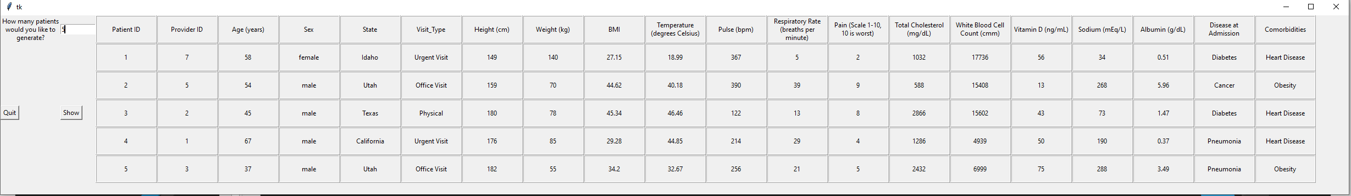
Module 1: Data Generation

Slide 8
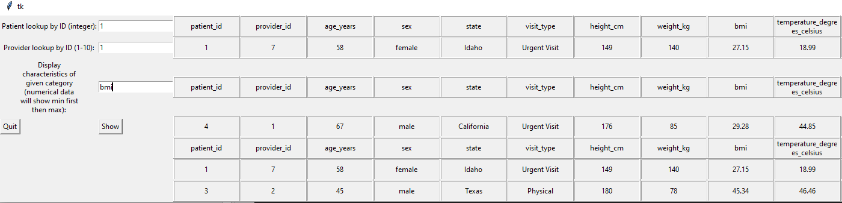
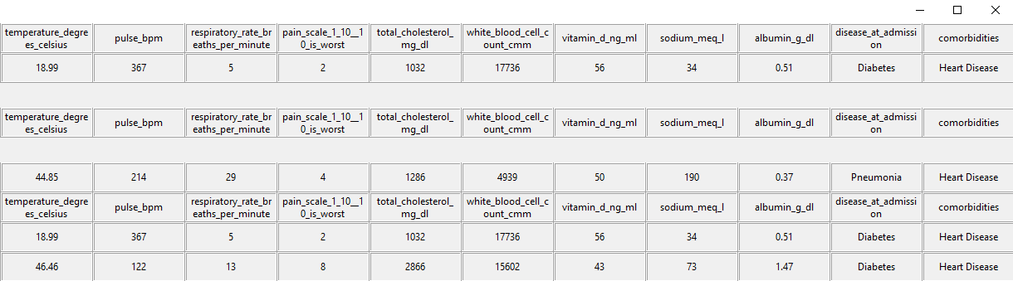
Module 2: ID Fetch and Extremes

Slide 9
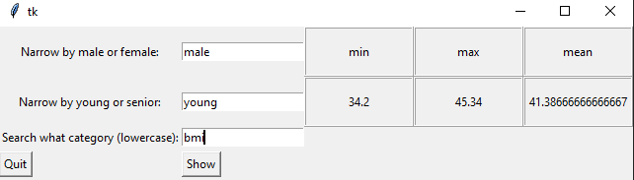
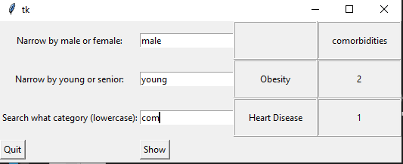
Module 2: Patient Stats By Demographic

Slide 10
Challenges
Implementing GUI, it was hard to understand how to display information because output type of each module was different
Solution: Write it all to csv
Writing to csv was also confusing, particularly how to generate patient data to csv
Solution: Create list of dictionaries for each individual patient and match to header
Source: My roommate’s girlfriend who is a software engineer
How to visualize a boxplot in VScode
Solution: Download jupyter (deprecated) to plot boxplot

